Slide 1
Employee Data Analysis using Excel
STUDENT NAME: Thrisha. V
REGISTER NO: 122202329
NM ID: (1B7DF682FFC54E49C5A474C0A08CD8BA)
DEPARTMENT:B.COM(Corporate Secretaryship)
COLLEGE: Valliammal college for women (VCW)

Slide 2
PROJECT TITLE
Employee Salary Analysis using Excel

Slide 3


AGENDA
Problem Statement
Project Overview
End Users
Our Solution and Proposition
Dataset Description
Modelling Approach
Results and Discussion
Conclusion
3/21/2024 Annual Review

Slide 4

PROBLEM STATEMENT
Salary represents a fixed and predetermined remuneration granted by an employer to an employee in exchange for their provided services or work.
Salary base among the employee from the different sectors are used the excel technique for the performance analysis.

Slide 5

PROJECT OVERVIEW
Employee Salary records in the company.

Slide 6
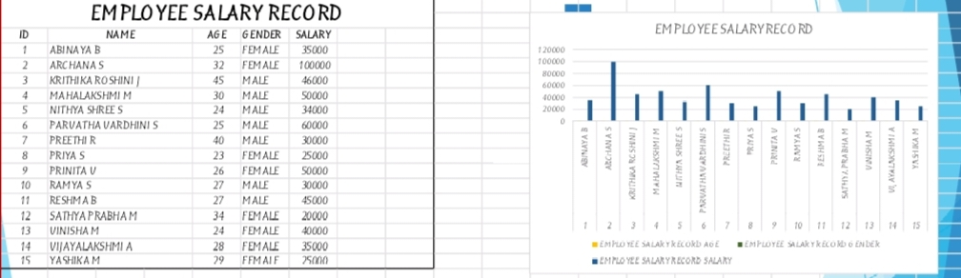

WHO ARE THE END USERS?

Slide 7

OUR SOLUTION AND ITS VALUE PROPOSITION
Sorting- The alphabetic order
Filtering- Remove missing value
Formula- Excel formula
Graph- Bar diagram

Slide 8
Dataset Description
Employee records: Salary records of employee in the company.
Employee ID : 1, 2, 3, 4, 5, 6, 7, 8, 9, 10, 11, 12, 13, 14, 15.
Salary : Higher and Lower

Slide 9
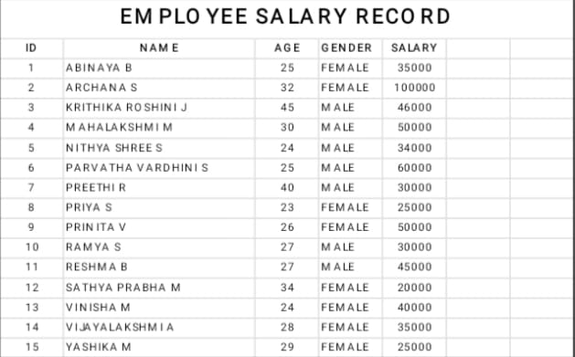

THE "WOW" IN OUR SOLUTION
The wow factor consists the salary records of employee working in the company. I used the bar diagram.
3/21/2024 Annual Review
9

Slide 10
MODELLING
Data set: Employee Database
Feature selection: Salary base
Data cleaning: Missing value, irrelevant
Sorting and filter, gender, employee ID
and salary.
Chart: Bar diagaram.
10

Slide 11
RESULTS
11

Slide 12
conclusion
The main aim to analysis the employee performance through the salary base. Greater things
In business are never done by one person. They are done by a team of people.

